Slide 1
Project 3 WIP May 4 Tableau
File created on: 5/6/2019 9:57:42 PM

Slide 2
Pre Machine Learning Model Tableau Data Review
Original data set has over 1,800 columns of national housing data
Scoped the data to around 20 housing + neighborhood features along with market value records
Used Tableau to review different data points correlation to Market Value – to hone in on which values to focus on in building the ML model

Slide 3
Initial Data Review – Market Value as a Dimension is Noisy

Slide 4
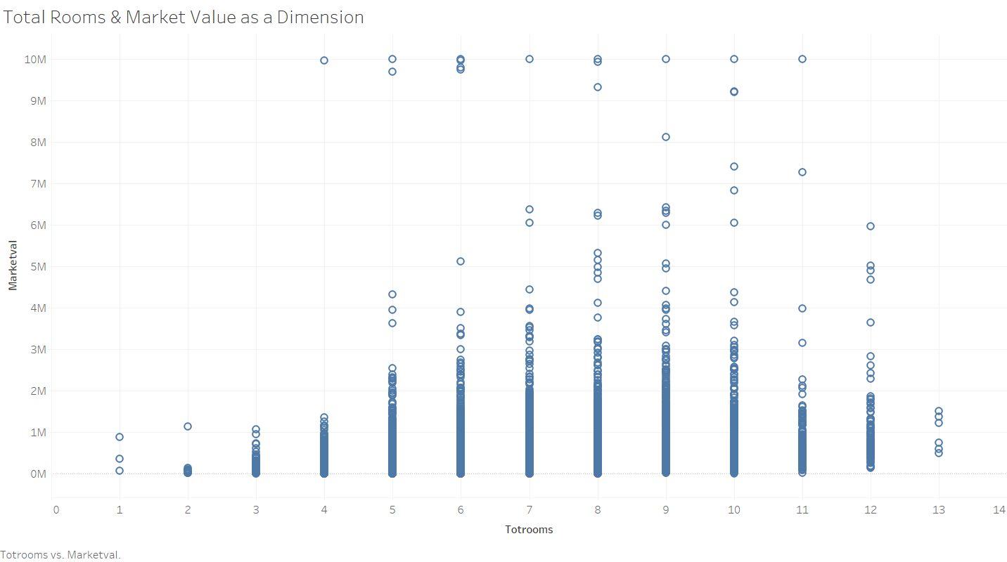

Slide 5
Used Average Market Value to Find Strong Correlation to Features That Drive Value

Slide 6
Housing Features w/Weak Correlation to Average Market Value

Slide 7
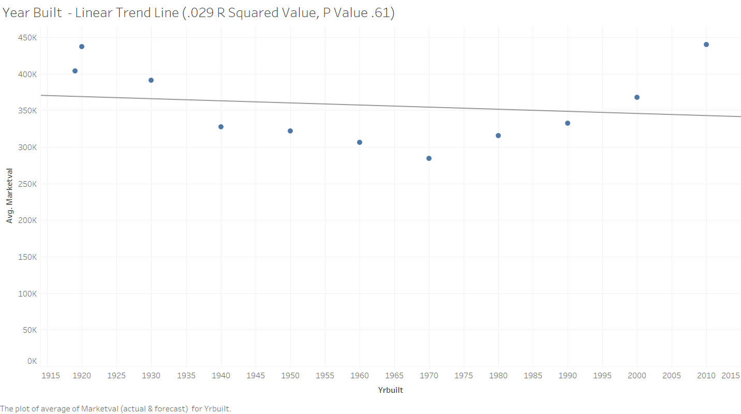

Slide 8
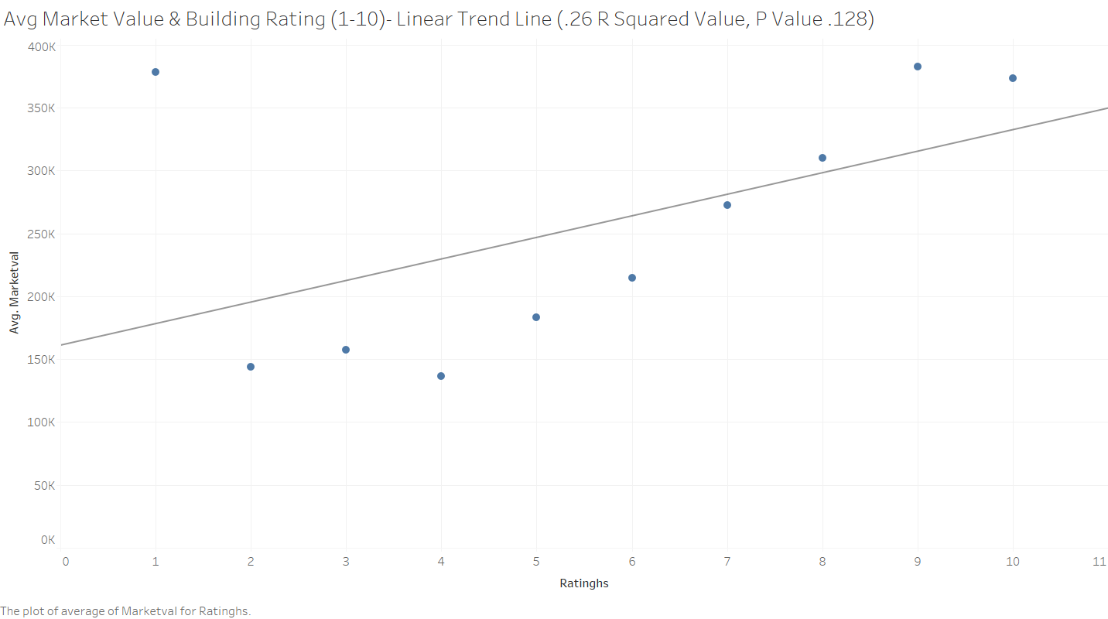

Slide 9
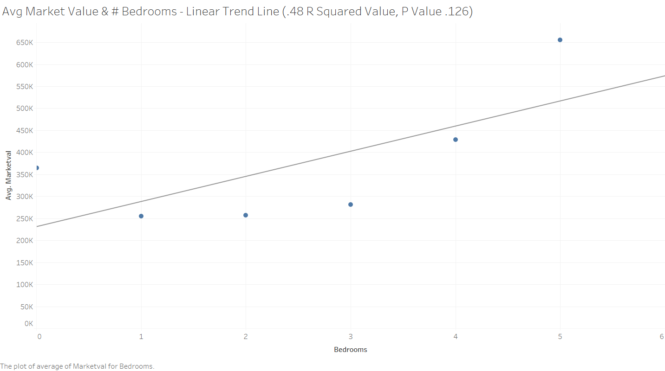

Slide 10
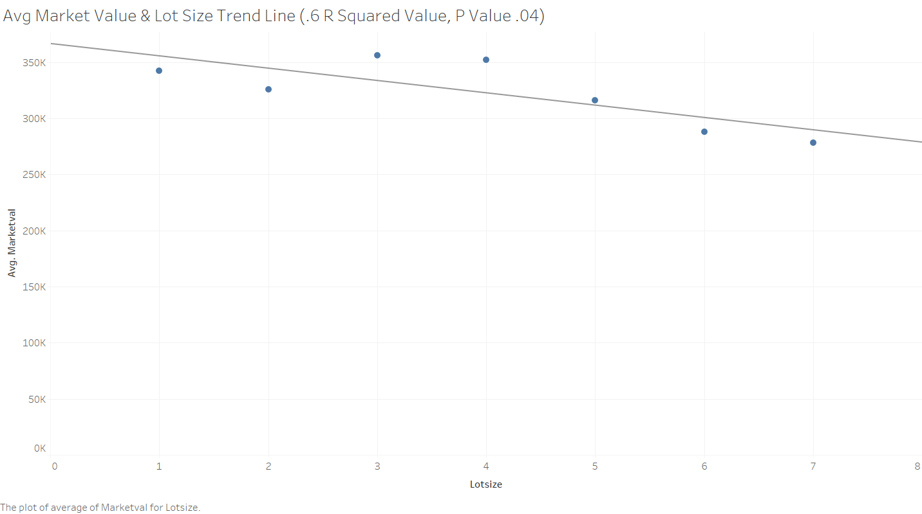

Slide 11
Housing Features w/Strong Correlation to Average Market Value

Slide 12
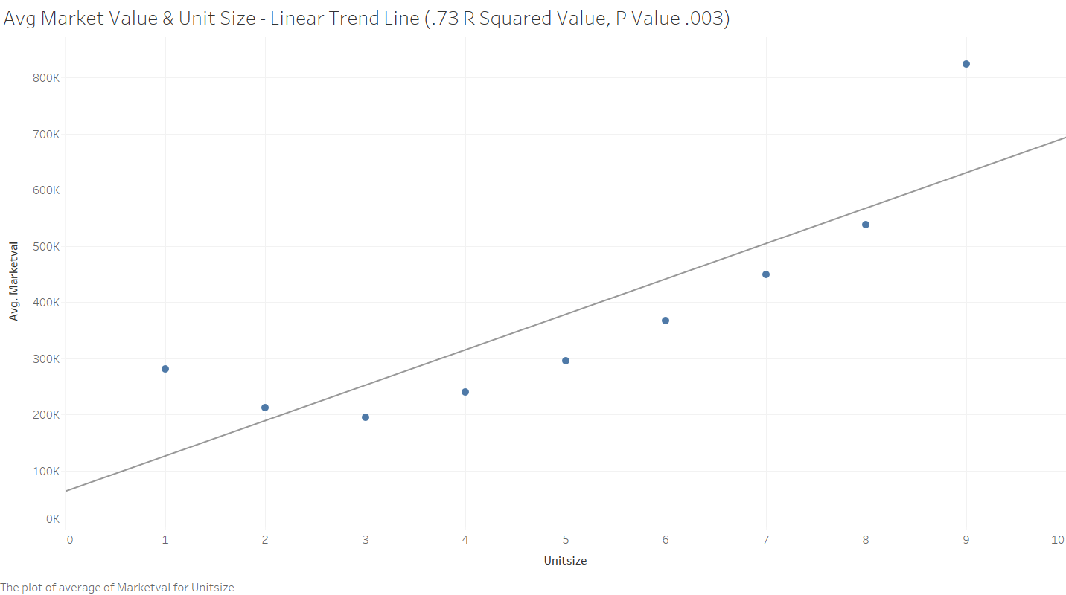

Slide 13
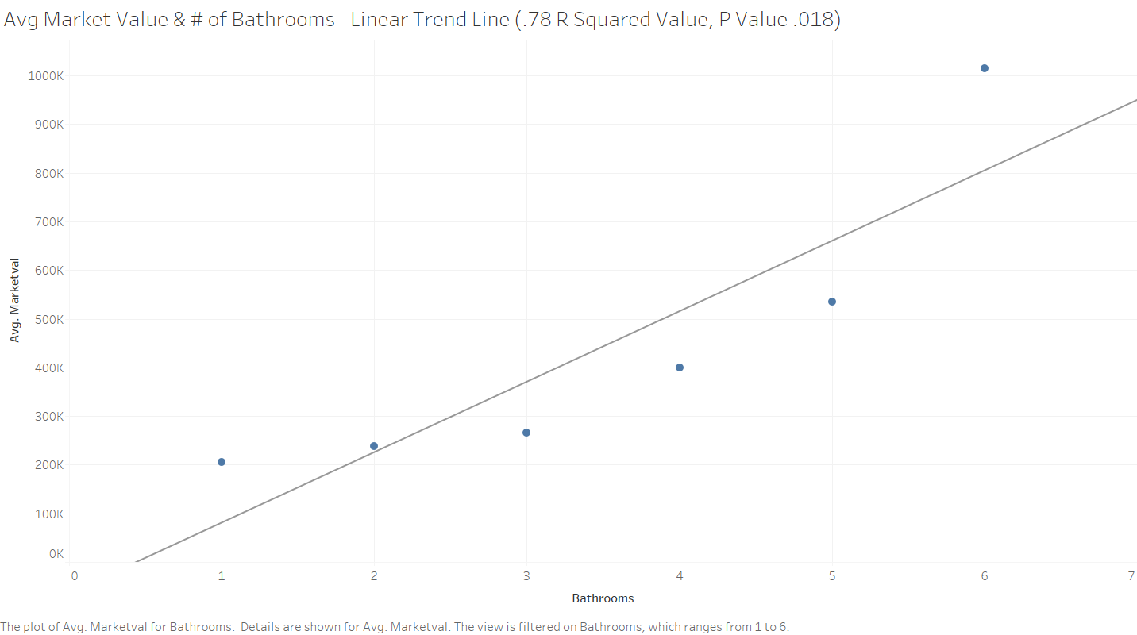

Slide 14
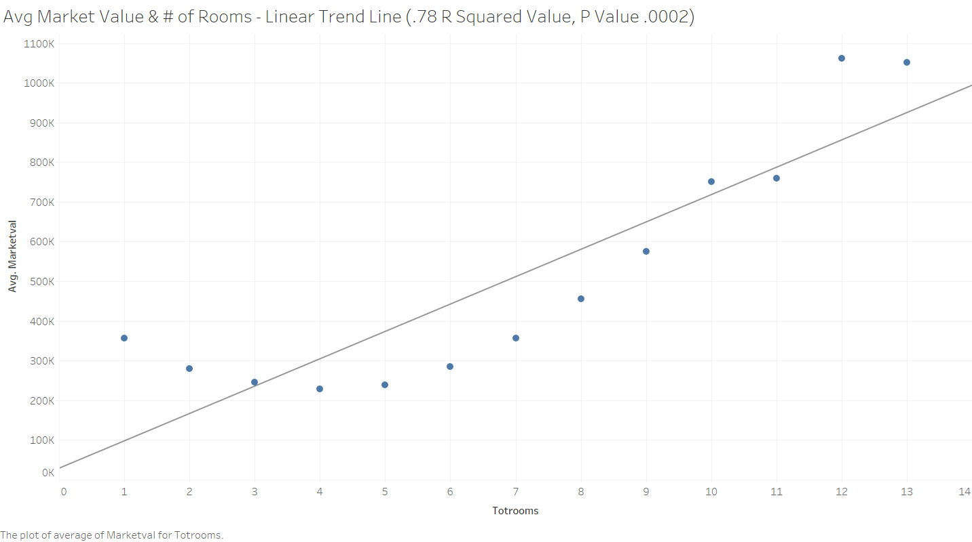

Slide 15
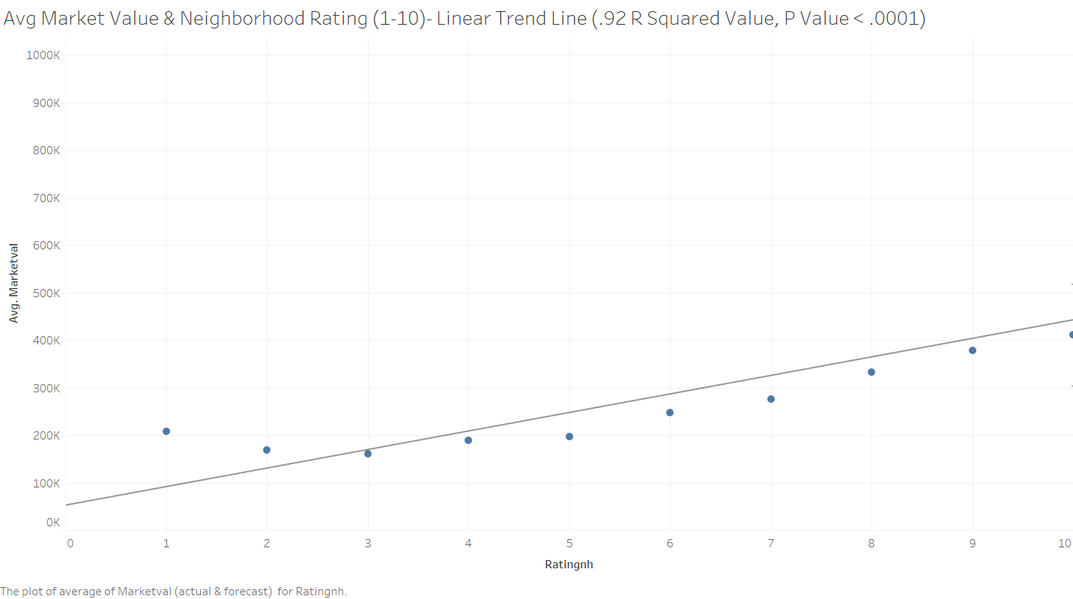

Slide 16
Interesting Trend Data We Found

Slide 17
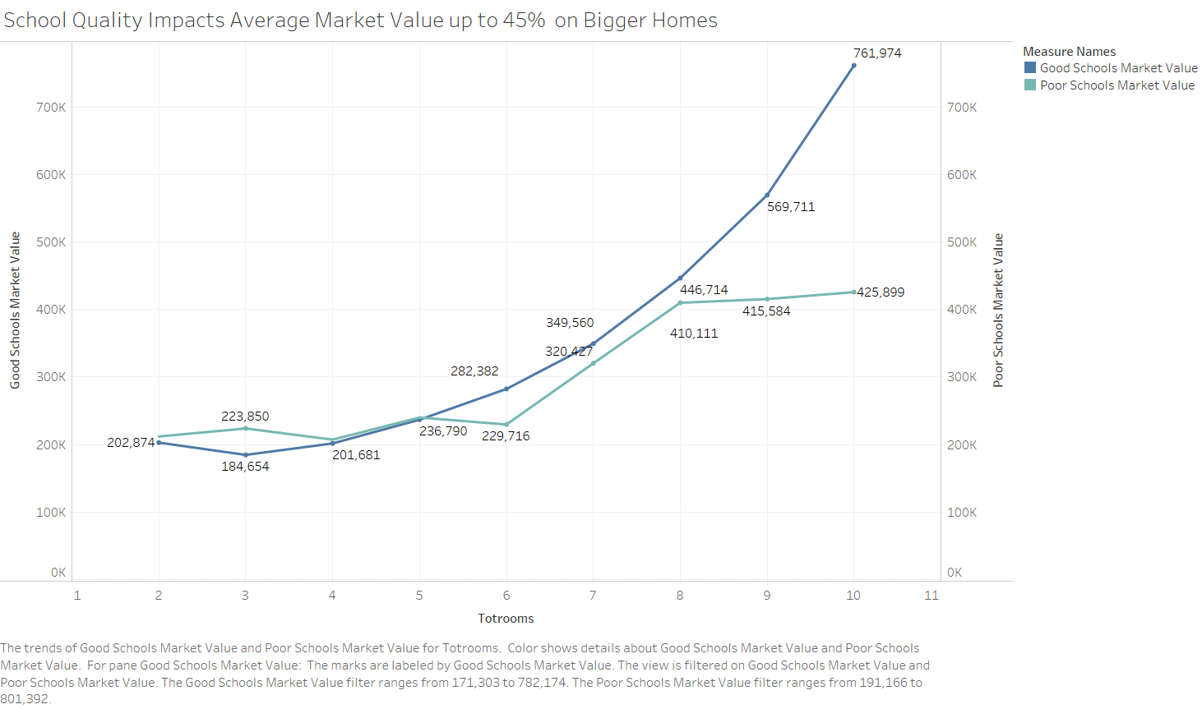

Slide 18
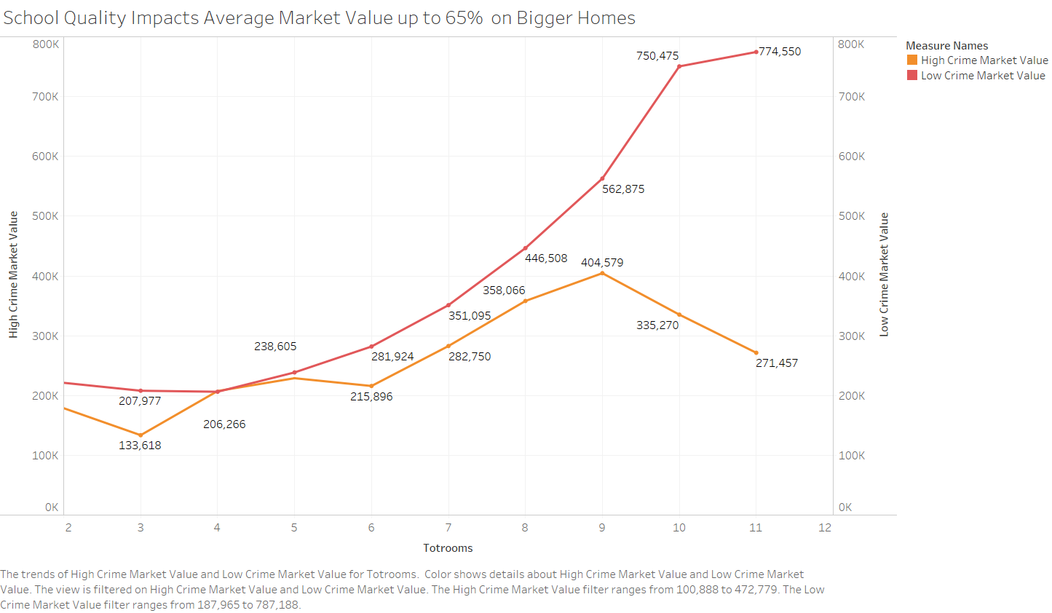

Slide 19
Appendix/Optional Slides

Slide 20
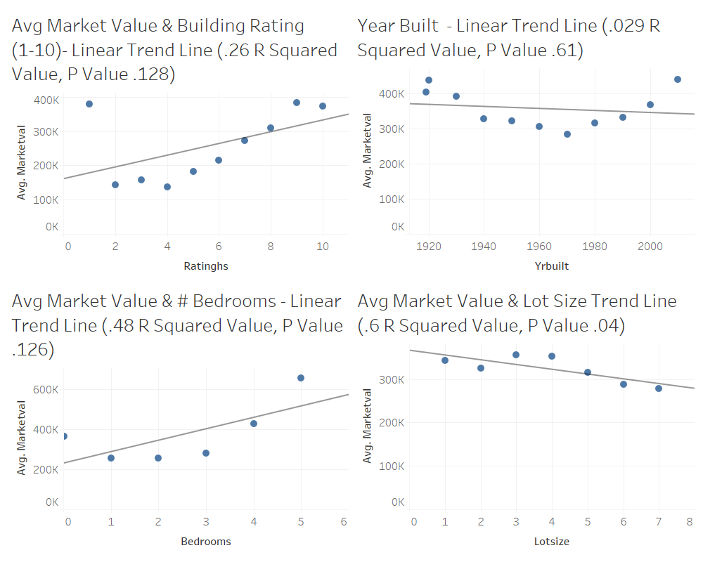

Slide 21
